Slide 1
A Gentle Introduction to TiDB
Get certified, FAST!

Slide 2
Objectives
After attending this workshop, you will be able to:
Explain the benefits of using TiDB Cloud to your friends /coworker
Explain the TiDB architecture to your friends / coworkers
Create a TiDB environment for learning
And…
Notes:
[no notes]

Slide 3
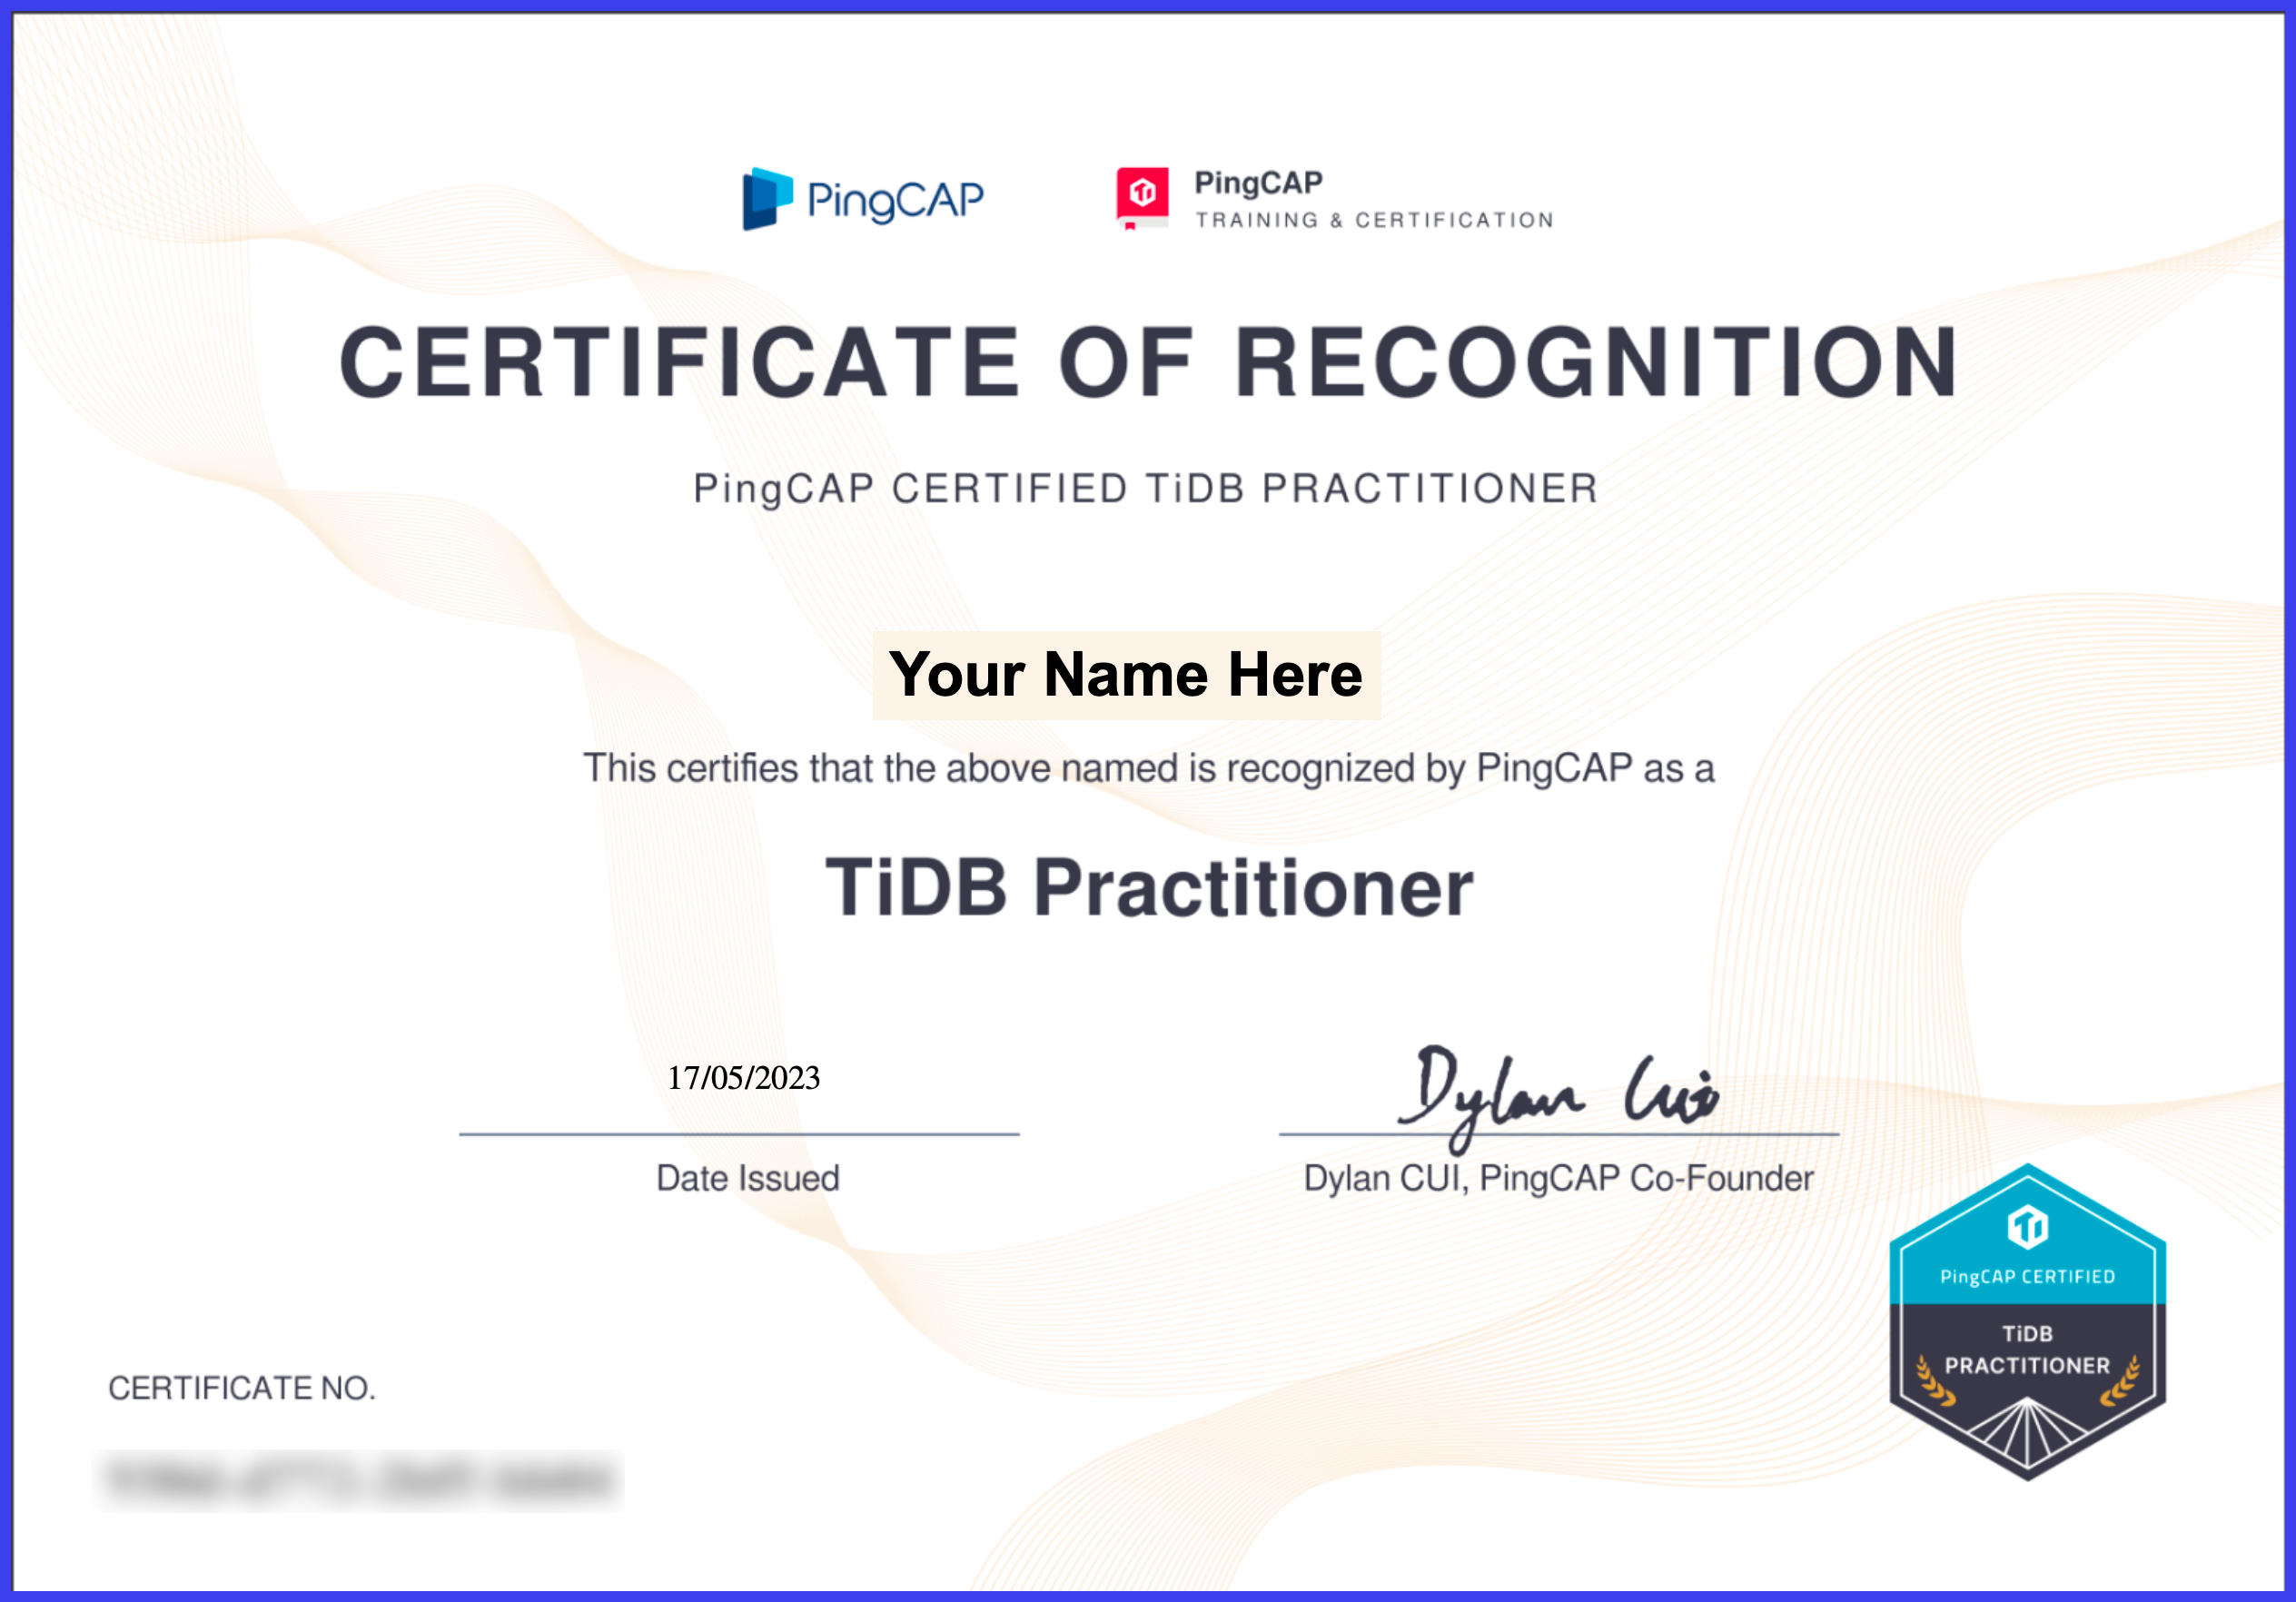
Objectives
Earn the PingCAP Certified TiDB Practitioner credential
After attending this workshop, you will be able to:
Describe the TiDB cluster architecture
Describe the TiDB SQL layer cluster
Describe the TiKV storage cluster
Describe HTAP features
Describe the benefits of using TiDB Cloud
Create TiDB Playground cluster by using TiUP
Get started with TiDB Cloud Serverless Tier
And…
Notes:
This workshop you are in is all you need to pass the exam. That said, you may have to take it more than once, but that is fine because it is FREE!

Slide 4
Objectives
After attending this workshop, you will be able to:
Explain the benefits of using TiDB Cloud to your friends /coworker
Explain the TiDB architecture to your friends / coworkers
Create a TiDB environment for learning
Show everyone your new TiDB Practitioner certification.
Notes:
[no notes]

Slide 5
What are the TiDB Use Cases?

Slide 6
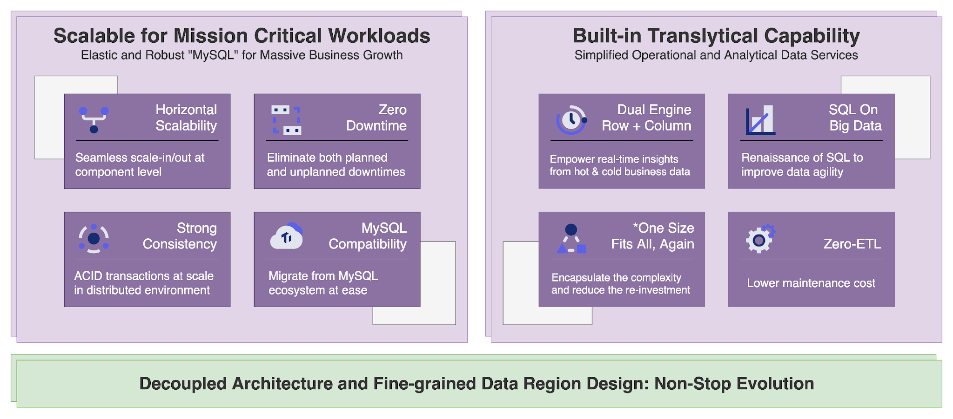
Why would you choose to use TiDB?

Slide 7
TiDB Workloads
TiDB (and TiDB Cloud) supports the following workloads:
24/7 availability with High I/O activity
Sharded (partitioned) data that routinely needs new shards
Large database that is growing rapidly
Database Consolidaton

Slide 8
TiDB Workloads – Database Consolidation
Database Consolidation means:
Combining multiple MySQL compatible servers into a single TiDB cluster
Merge multiple sharded database schemas into a single TiDB cluster
Important: This is not a data modeling exercise. This is lift-and-shift type of work.

Slide 9
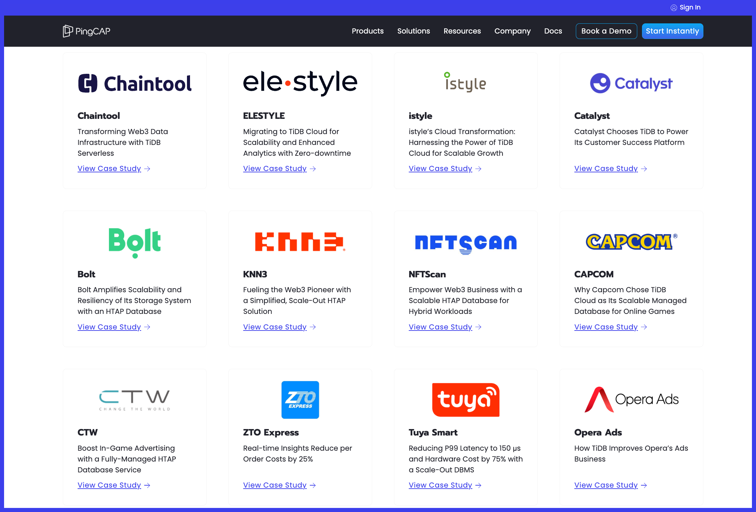
TiDB is Trusted by Global Innovation Leaders
pingcap.com/customers/

Slide 10
MySQL Family

Slide 11
What is the MySQL Family?
To be in the MySQL Family a database must:
Use the MySQL dialect of SQL
Be drop-in compatible with MySQL
TiDB Cloud
Percona Server for MySQL
TiDB
MySQL
Amazon Aurora (MySQL variant)
MariaDB
Notes:
Notice that we don’t require that the database be based on MySQL source code.

Slide 12
What is the MySQL Family?
To be in the MySQL Family a database must:
Use the MySQL dialect of SQL
Be drop-in compatible with MySQL
Why does the idea of
MySQL Family
matter to us?
TiDB Cloud
Percona Server for MySQL
TiDB
MySQL
Amazon Aurora (MySQL variant)
MariaDB
Notes:
Notice that we don’t require that the database be based on MySQL source code.

Slide 13
TiDB Architecture

Slide 14
TiDB – The complete picture
Placement Driver Cluster
PD
PD
PD
TSO / Data Location
Metadata
TSO / Data Location
TiDB
Cluster
Storage Cluster
TiSpark
MySQL protocol
TiDB
TiKV
TiKV
Spark Driver
DistSQL
API
DistSQL
API
TiDB
TiKV
TiKV
Spark Cluster
Worker
MySQL protocol
TiDB
TiKV
TiKV
Application
KV API
KV API
Worker
Spark SQL
TiDB
TiFlash
Worker
. . .
TiFlash
. . .
. . .
MySQL protocol
. . .

Slide 15
TiDB – Is built using components
Placement Driver Cluster
PD
PD
PD
TSO / Data Location
Metadata
TSO / Data Location
TiDB
Cluster
Storage Cluster
TiSpark
MySQL protocol
TiDB
TiKV
TiKV
Spark Driver
DistSQL
API
DistSQL
API
TiDB
TiKV
TiKV
Spark Cluster
Worker
MySQL protocol
TiDB
TiKV
TiKV
Application
KV API
KV API
Worker
Spark SQL
TiDB
TiFlash
Worker
. . .
TiFlash
. . .
. . .
MySQL protocol
. . .

Slide 16
TiDB Components

Slide 17
TiDB – it begins with a connection
Users connect to TiDB as a MySQL application.
Application users:
Usually, you won’t care.
Applications that can connect to MySQL can connect to TiDB.
ODBC (Excel, Tableau, etc)
JDBC (Tableau, Looker, etc.)
API (MySQL Admin)
Developers / Programmers:
ODBC
JDBC
Various MySQLConnectors
MySQL protocol
MySQL protocol
Application
MySQL protocol

Slide 18
TiDB – runs SQL commands
TiDB:
Is the name of the entire system and a component.
The MySQL client connects here.
Handles SQL requests.
Performs SQL parsing.
Generates distributed SQL execution plans.
Returns query results to the MySQL client.
Stateless.
Scalable (you can add/remove TiDB servers)
TiDB
Cluster
MySQL protocol
TiDB
TiDB
MySQL protocol
TiDB
Application
TiDB
. . .
MySQL protocol

Slide 19
TiKV – stores (transactional) data
TiKV server:
Provides storage for the TiDB component.
Row-based data store (Used for Online Transaction Processing (OLTP) data)
Data is distributed.
Maintains multiple replicas.
High availability (supports automatic failover).
Can be used without TiDB.
Stores data in Key-Value pairs.
TiDB
Cluster
Storage Cluster
MySQL protocol
TiDB
TiKV
TiKV
DistSQL
API
TiDB
TiKV
TiKV
MySQL protocol
TiDB
TiKV
TiKV
Application
KV API
TiDB
. . .
MySQL protocol
. . .

Slide 20
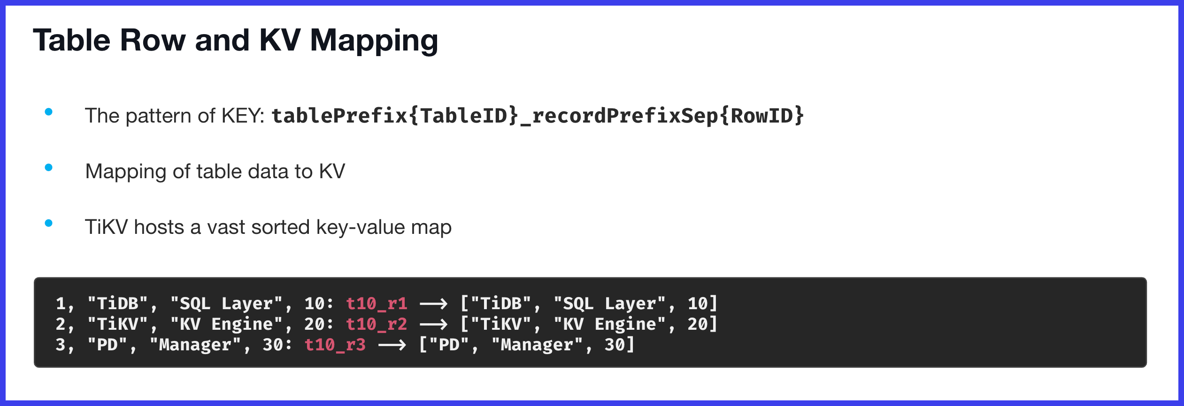
TiKV – stores (transactional) data
TiKV server:
Provides storage for the TiDB component.
Row-based data store (Used for Online Transaction Processing (OLTP) data)
Data is distributed.
Maintains multiple replicas.
High availability (supports automatic failover).
Can be used without TiDB.
Stores data in Key-Value pairs.
TiDB
Cluster
Storage Cluster
MySQL protocol
TiDB
TiKV
TiKV
DistSQL
API
TiDB
TiKV
TiKV
MySQL protocol
TiDB
TiKV
TiKV
Application
KV API
TiDB
. . .
MySQL protocol
. . .

Slide 21

Inside TiKV – Multi-Version Concurrency Control
TiKV
TiKV is the storage layer
TiDB (SQL processor) uses the KV API to talk to TiKV.
Not all SQL processing is performed by the TiDB component.
The TiKV Coprocessor handles some processing: filters, mapping, count, sum, and more)
This increases parallelism.
Implements ACID capabilities.
TiKV uses Google's Percolator module and uses Optimistic locking for transactions.
MVCC creates a new version of the data object instead of updating in-place.
Current readers can see older version while the UPDATE transaction runs.
MVCC does not require locking.
KV API
Co-processor
Transaction
Multi-Version Concurrency Control (MVCC)
RocksDB
Raft

Slide 22
Inside TiKV - RocksDB
TiKV
RocksDB is a persistent key-value store.
Each TiKV node uses two instances of RocksDB. One for the key-value pairs and another for the Raft logs.
KV API
Co-processor
Transaction
Multi-Version Concurrency Control (MVCC)
RocksDB
Raft

Slide 23
Inside TiKV - Raft
TiKV
RocksDB is a persistent key-value store.
Each TiKV node uses two instances of RocksDB. One for the key-value pairs and another for the Raft logs.
Raft is used to achieve the data consistency among the Replicas.
KV API
Co-processor
Transaction
Multi-Version Concurrency Control (MVCC)
RocksDB
Raft

Slide 24
More about Raft

Slide 25
TiKV nodes places data in Stores
Client
Placement
Driver server
RPC
RPC
RPC
RPC
PD 1
TiKV node 1
TiKV node 2
TiKV node 3
TiKV node 4
PD 2
Store 1
Store 2
Store 3
Store 4
PD 3
Each TiKV node contains one or more STORES.
A STORE is a TiKV Process that manages data storage.

Slide 26
The basic unit of TiKV data is the Region
Client
Placement
Driver server
RPC
RPC
RPC
RPC
PD 1
TiKV node 1
TiKV node 2
TiKV node 3
TiKV node 4
REGION – the basic unit of data movement.
Each REGIONs data is copied to multiple nodes.
PD 2
Store 1
Store 2
Store 3
Store 4
Region 1
Region 1
Region 2
Region 1
PD 3
Region 3
Region 2
Region 5
Region 2
Region 5
Region 4
Region 3
Region 5
Region 4
Region 3
Region 4

Slide 27
How many Regions are there?
Client
Placement
Driver server
RPC
RPC
RPC
RPC
PD 1
TiKV node 1
TiKV node 2
TiKV node 3
TiKV node 4
PD 2
Store 1
Store 2
Store 3
Store 4
Region 1
Region 1
Region 2
Region 1
PD 3
Region 3
Region 2
Region 5
Region 2
Region 5
Region 4
Region 3
Region 5
Region 4
Region 3
Region 4

Slide 28
TiKV replicates data
By default:
There are 3 replicas.
Each replica is at most 96MB
Client
Placement
Driver server
RPC
RPC
RPC
RPC
PD 1
TiKV node 1
TiKV node 2
TiKV node 3
TiKV node 4
PD 2
Store 1
Store 2
Store 3
Store 4
REPLICAS
Region 1
Region 1
Region 2
Region 1
PD 3
Region 3
Region 2
Region 5
Region 2
Region 5
Region 4
Region 3
Region 5
Region 4
Region 3
Region 4

Slide 29
TiKV replicates data
How do we keep the data in sync?
Consistent?
By default:
There are 3 replicas.
Each replica is at most 96k
Client
Placement
Driver server
RPC
RPC
RPC
RPC
PD 1
TiKV node 1
TiKV node 2
TiKV node 3
TiKV node 4
PD 2
Store 1
Store 2
Store 3
Store 4
REPLICAS
REPLICAS
Region 1
Region 1
Region 2
Region 1
PD 3
Region 3
Region 2
Region 5
Region 2
Region 5
Region 4
Region 3
Region 5
Region 4
Region 4
Region 3
Region 4
Region 4
Region 4

Slide 30
TiKV – Key-Value Data Persisted in RocksDB
TiKV server:
Provides storage for the TiDB component.
Row-based data store (Used for Online Transaction Processing (OLTP) data)
Data is distributed.
Maintains multiple replicas.
High availability (supports automatic failover).
Can be used without TiDB.
Stores data in Key-Value pairs.
Data stored in RocksDB!
TiDB
Cluster
Storage Cluster
MySQL protocol
TiDB
TiKV
TiKV
DistSQL
API
TiDB
TiKV
TiKV
MySQL protocol
TiDB
TiKV
TiKV
Application
KV API
TiDB
. . .
MySQL protocol
. . .

Slide 31
TiKV – Key-Value Data Persisted in RocksDB
TiKV server:
Provides storage for the TiDB component.
Row-based data store (Used for Online Transaction Processing (OLTP) data)
Data is distributed.
Maintains multiple replicas.
High availability (supports automatic failover).
Can be used without TiDB.
Stores data in Key-Value pairs.
Data stored in RocksDB!
TiDB
Cluster
Storage Cluster
MySQL protocol
TiDB
TiKV
TiKV
You may want to remember this!
DistSQL
API
TiDB
TiKV
TiKV
MySQL protocol
TiDB
TiKV
TiKV
Application
KV API
TiDB
. . .
MySQL protocol
. . .

Slide 32
TiFlash – stores analytics data
TiFlash server:
Also provides storage for the TiDB component.
Columnar data store. (Used for analytic data)
Data is distributed.
Data can be distributed across physical locations.
Not open source (yet)
TiDB
Cluster
Storage Cluster
MySQL protocol
TiDB
TiKV
TiKV
DistSQL
API
TiDB
TiKV
TiKV
MySQL protocol
TiDB
TiKV
TiKV
Application
KV API
TiDB
TiFlash
. . .
TiFlash
MySQL protocol
. . .

Slide 33
Placement Driver – the environment needs a brain
Placement Driver Cluster
PD
PD
PD
TSO / Data Location
Metadata
PD cluster:
Contains the metadata for the TiDB cluster.
Allocates transaction IDs to distribute transactions.
One PD cluster consists of at least three nodes.
Hosts a web server that runs the TiDB Dashboard (management UI)
TiDB
Cluster
Storage Cluster
MySQL protocol
TiDB
TiKV
TiKV
DistSQL
API
TiDB
TiKV
TiKV
MySQL protocol
TiDB
TiKV
TiKV
Application
KV API
TiDB
TiFlash
. . .
TiFlash
MySQL protocol
. . .

Slide 34
TiSpark – in-memory analytics is a must-have
Placement Driver Cluster
PD
PD
PD
TSO / Data Location
Metadata
TSO / Data Location
TiSpark Query Library:
Runs Apache Spark SQL on TiKV
Integrates with Spark Catalyst engine.
Supports distributed writes to TiKV.
TiDB
Cluster
Storage Cluster
TiSpark
MySQL protocol
TiDB
TiKV
TiKV
Spark Driver
DistSQL
API
DistSQL
API
TiDB
TiKV
TiKV
Spark Cluster
Worker
MySQL protocol
TiDB
TiKV
TiKV
Application
KV API
KV API
Worker
Spark SQL
TiDB
TiFlash
Worker
. . .
TiFlash
. . .
. . .
MySQL protocol
. . .

Slide 35
TiSpark – in-memory analytics is a must-have
Placement Driver Cluster
PD
PD
PD
TSO / Data Location
Metadata
TSO / Data Location
TiSpark Query Library:
Runs Apache Spark SQL on TiKV
Integrates with Spark Catalyst engine.
Supports distributed writes to TiKV.
Optional on self-hosted…
and… Not available on TiDB Cloud
TiDB
Cluster
Storage Cluster
TiSpark
MySQL protocol
TiDB
TiKV
TiKV
Spark Driver
DistSQL
API
DistSQL
API
TiDB
TiKV
TiKV
Spark Cluster
Worker
MySQL protocol
TiDB
TiKV
TiKV
Application
KV API
KV API
Worker
Spark SQL
TiDB
TiFlash
Worker
. . .
TiFlash
. . .
. . .
MySQL protocol
. . .

Slide 36
TiSpark – in-memory analytics is a must-have
Placement Driver Cluster
PD
PD
PD
TSO / Data Location
Metadata
TSO / Data Location
TiSpark Query Library:
Runs Apache Spark SQL on TiKV
Integrates with Spark Catalyst engine.
Supports distributed writes to TiKV.
Akshully, optional on self-hosted…
and… Not available on TiDB Cloud
TiDB
Cluster
Storage Cluster
TiSpark
MySQL protocol
TiDB
TiKV
TiKV
Spark Driver
DistSQL
API
DistSQL
API
TiDB
TiKV
TiKV
Spark Cluster
Worker
MySQL protocol
TiDB
TiKV
TiKV
Application
KV API
KV API
Worker
Spark SQL
TiDB
TiFlash
Worker
. . .
TiFlash
. . .
. . .
MySQL protocol
. . .

Slide 37
A User App Connects to TiDB
Placement Driver Cluster
PD
PD
PD
TSO / Data Location
Metadata
TSO / Data Location
MyApp
TiDB
Cluster
Storage Cluster
TiSpark
MySQL protocol
TiDB
TiKV
TiKV
Spark Driver
DistSQL
API
DistSQL
API
TiDB
TiKV
TiKV
Spark Cluster
Worker
MySQL protocol
TiDB
TiKV
TiKV
Application
KV API
KV API
Worker
Spark SQL
TiDB
TiFlash
Worker
. . .
TiFlash
. . .
. . .
MySQL protocol
. . .

Slide 38
A User App Connects to TiDB
Placement Driver Cluster
PD
PD
PD
Do I have to know all these IP addresses?
TSO / Data Location
Metadata
TSO / Data Location
MyApp
TiDB
Cluster
Storage Cluster
TiSpark
MySQL protocol
TiDB
TiKV
TiKV
Spark Driver
DistSQL
API
DistSQL
API
TiDB
TiKV
TiKV
Spark Cluster
Worker
MySQL protocol
TiDB
TiKV
TiKV
Application
KV API
KV API
Worker
Spark SQL
TiDB
TiFlash
Worker
. . .
TiFlash
. . .
. . .
MySQL protocol
. . .

Slide 39
A User App Connects to TiDB
Placement Driver Cluster
PD
PD
PD
TSO / Data Location
Metadata
TSO / Data Location
Self-managed deployments do not include a Load Balancer.
TiDB Cloud (Serverless and Dedicated) Includes a Load Balancer.
MyApp
Load Balancer
TiDB
Cluster
Storage Cluster
TiSpark
MySQL protocol
TiDB
TiKV
TiKV
Spark Driver
DistSQL
API
DistSQL
API
TiDB
TiKV
TiKV
Spark Cluster
Worker
MySQL protocol
TiDB
TiKV
TiKV
Application
KV API
KV API
Worker
Spark SQL
TiDB
TiFlash
Worker
. . .
TiFlash
. . .
. . .
MySQL protocol
. . .

Slide 40
A User App Connects to TiDB
Placement Driver Cluster
PD
PD
PD
TSO / Data Location
Metadata
TSO / Data Location
MyApp
Load Balancer
TiDB
Cluster
Storage Cluster
TiSpark
MySQL protocol
TiDB
TiKV
TiKV
Spark Driver
The Load Balancer will choose which TiDB server your app connects to.
DistSQL
API
DistSQL
API
TiDB
TiKV
TiKV
Spark Cluster
Worker
MySQL protocol
TiDB
TiKV
TiKV
Application
KV API
KV API
Worker
Spark SQL
TiDB
TiFlash
Worker
. . .
TiFlash
. . .
. . .
MySQL protocol
. . .

Slide 41
TiDB SQL Processing

Slide 42
TiDB SQL Processing – what happens, where?
Placement Driver Cluster
PD
PD
PD
SQL Processing happens here!
TSO / Data Location
Metadata
TSO / Data Location
TiDB
Cluster
Storage Cluster
TiSpark
MySQL protocol
TiDB
TiKV
TiKV
Spark Driver
DistSQL
API
DistSQL
API
TiDB
TiKV
TiKV
Spark Cluster
Worker
MySQL protocol
TiDB
TiKV
TiKV
Application
KV API
KV API
Worker
Spark SQL
TiDB
TiFlash
Worker
. . .
TiFlash
. . .
. . .
MySQL protocol
. . .

Slide 43
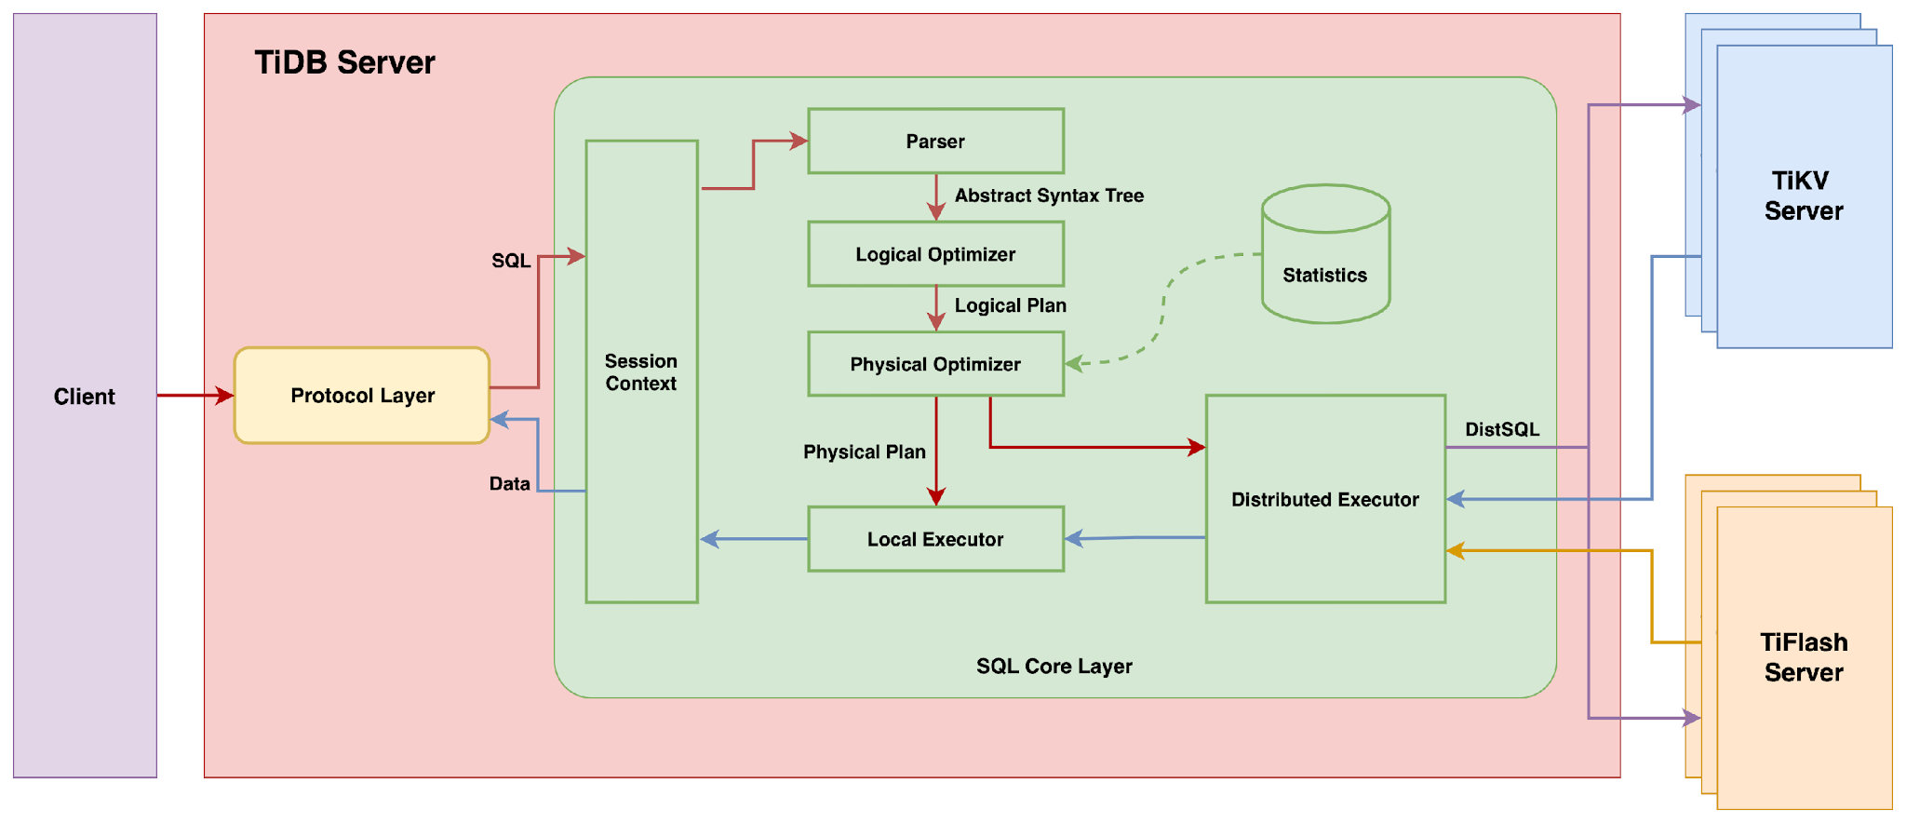
TiDB Server - SQL Processing

Slide 44
TiDB Server - SQL Processing
This is an application that is connecting to TiDB.

Slide 45
TiDB Server – Access Protocols
TiDB uses the MySQL access protocol.

Slide 46
TiDB Server – Access Protocols
MySQL Family in a nutshell:
A user can connect to TiDB and think she is connected to MySQL. What are the implications of this?
TiDB uses the MySQL access protocol.

Slide 47
TiDB Server – Parse and Optimize
The TiDB Server:
Parses the SQL
Optimizes the query.

Slide 48
TiDB Server – Accesses the data
The TiDB Server:
Accesses TiKV
Accesses TiFlash

Slide 49
TiDB Server – Accesses the data
The TiDB Server:
Accesses TiKV
Accesses TiFlash
Can Access BOTH TiKV and TiFlash within a single query!

Slide 50
TiDB Server – Back to Connections
Are we missing something here?

Slide 51
TiDB Server – Back to Connections
Are we missing something here?
A Single CLIENT CONNECTION can only connect to ONE TiDB Server instance!

Slide 52
Thorough Review

Slide 53
(True or False) I must install and configure a load balancer on a Dedicated TiDB Cloud cluster.
Question 01

Slide 54
(True or False) I must install and configure a load balancer on a Dedicated TiDB Cloud cluster.
Question 01
False

Slide 55
(True or False) TiKV Server stores in a columnar format
Question 02

Slide 56
(True or False) TiKV Server stores in a columnar format
Question 02
False

Slide 57
TiKV Server uses what storage technology to make TiDB data permanent?
Question 03

Slide 58
TiKV Server uses what storage technology to make TiDB data permanent?
Question 03
RocksDB

Slide 59
Which TiDB component ensures the durability of data?
Question 04

Slide 60
Which TiDB component ensures the durability of data?
Question 04
TiKV server

Slide 61
(True or False) The TiDB Playground cluster (launched by tiup) is adequate for production environments and/or heavy workloads.
Question 05

Slide 62
(True or False) The TiDB Playground cluster (launched by tiup) is adequate for production environments and/or heavy workloads.
Question 05
False

Slide 63
(True or False) TiFlash is useful for OLTP-only workloads.
Question 06

Slide 64
(True or False) TiFlash is useful for OLTP-only workloads.
Question 06
False

Slide 65
Briefly explain why you must always have the same number of TiDB servers and TiKV servers.
Question 07

Slide 66
Briefly explain why you must always have the same number of TiDB servers and TiKV servers.
Question 07
You can’t, because it isn’t true.
In TiDB, compute and storage can be scaled independently. This is very important!

Slide 67
(True or False) TiFlash is useful for OLTP-only workloads.
Question 08

Slide 68
(True or False) TiFlash is useful for OLTP-only workloads.
Question 08
False

Slide 69
Which ETL tool is recommended for migrating data between TiKV and TiFlash?
Question 09

Slide 70
Which ETL tool is recommended for migrating data between TiKV and TiFlash?
Question 09
Trick question! ETL isn’t required. TiDB handles it all for you.

Slide 71
(True or False) Multiple TiDB server instances can participate in executing a single Query.
Question 10

Slide 72
(True or False) Multiple TiDB server instances can participate in executing a single Query.
Question 10
False

Slide 73
Get Certified NOW!

Slide 75
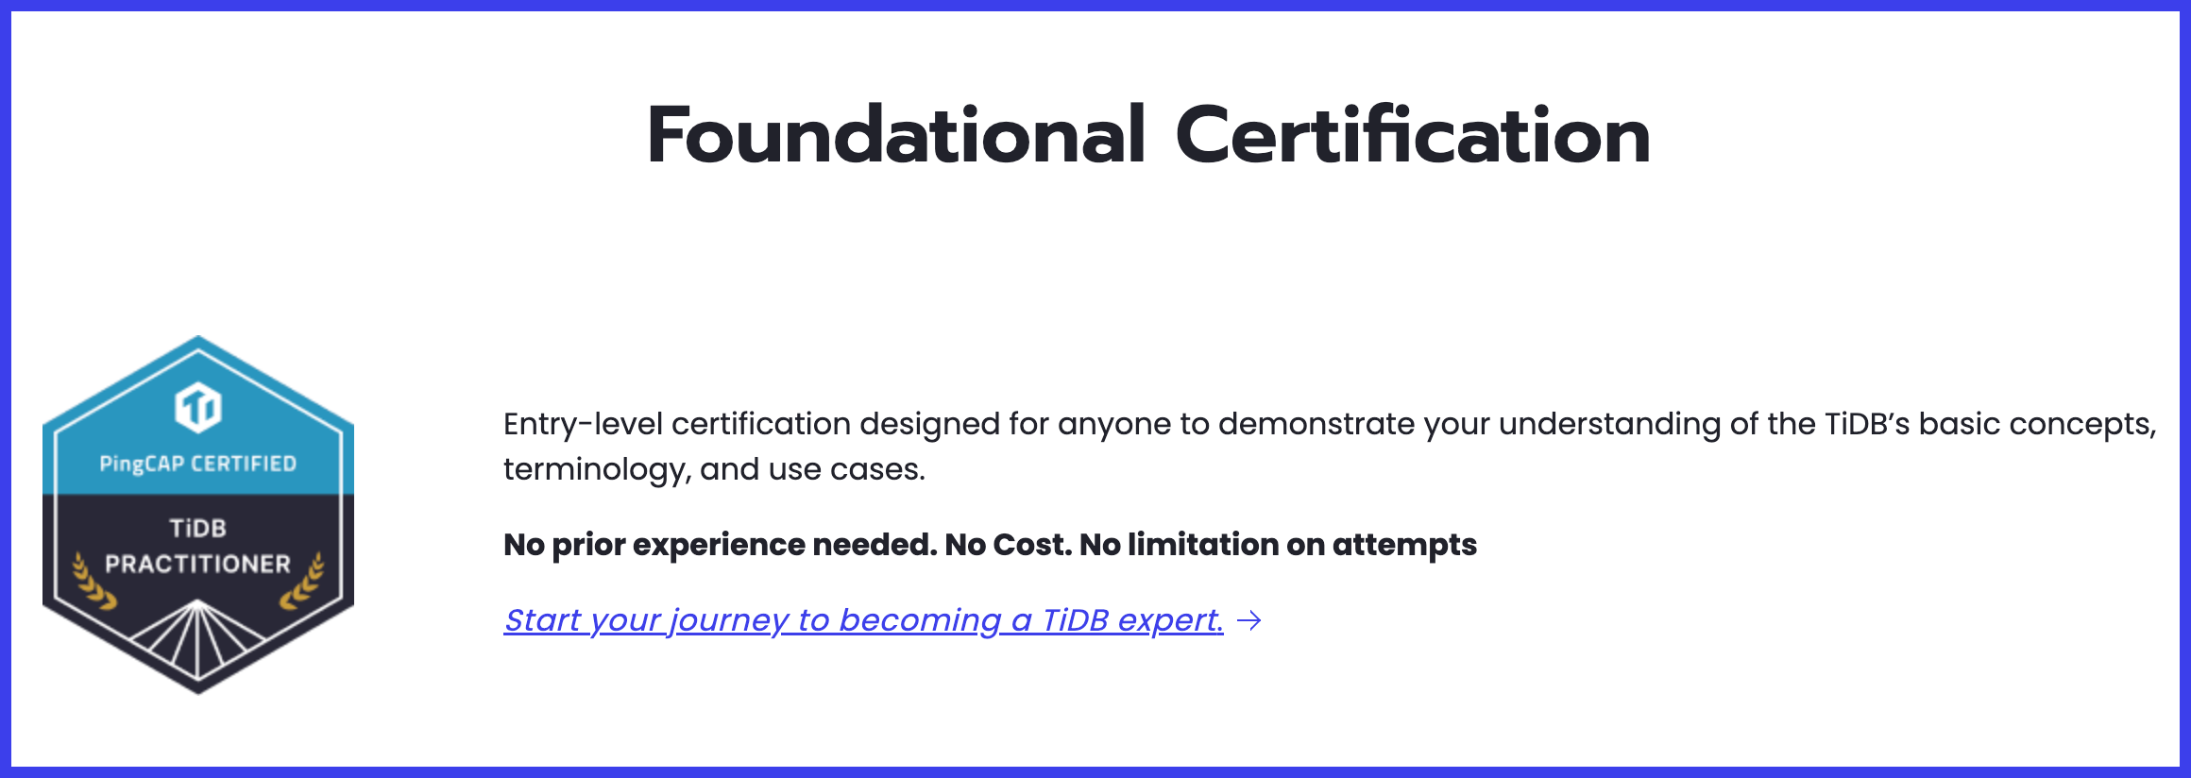
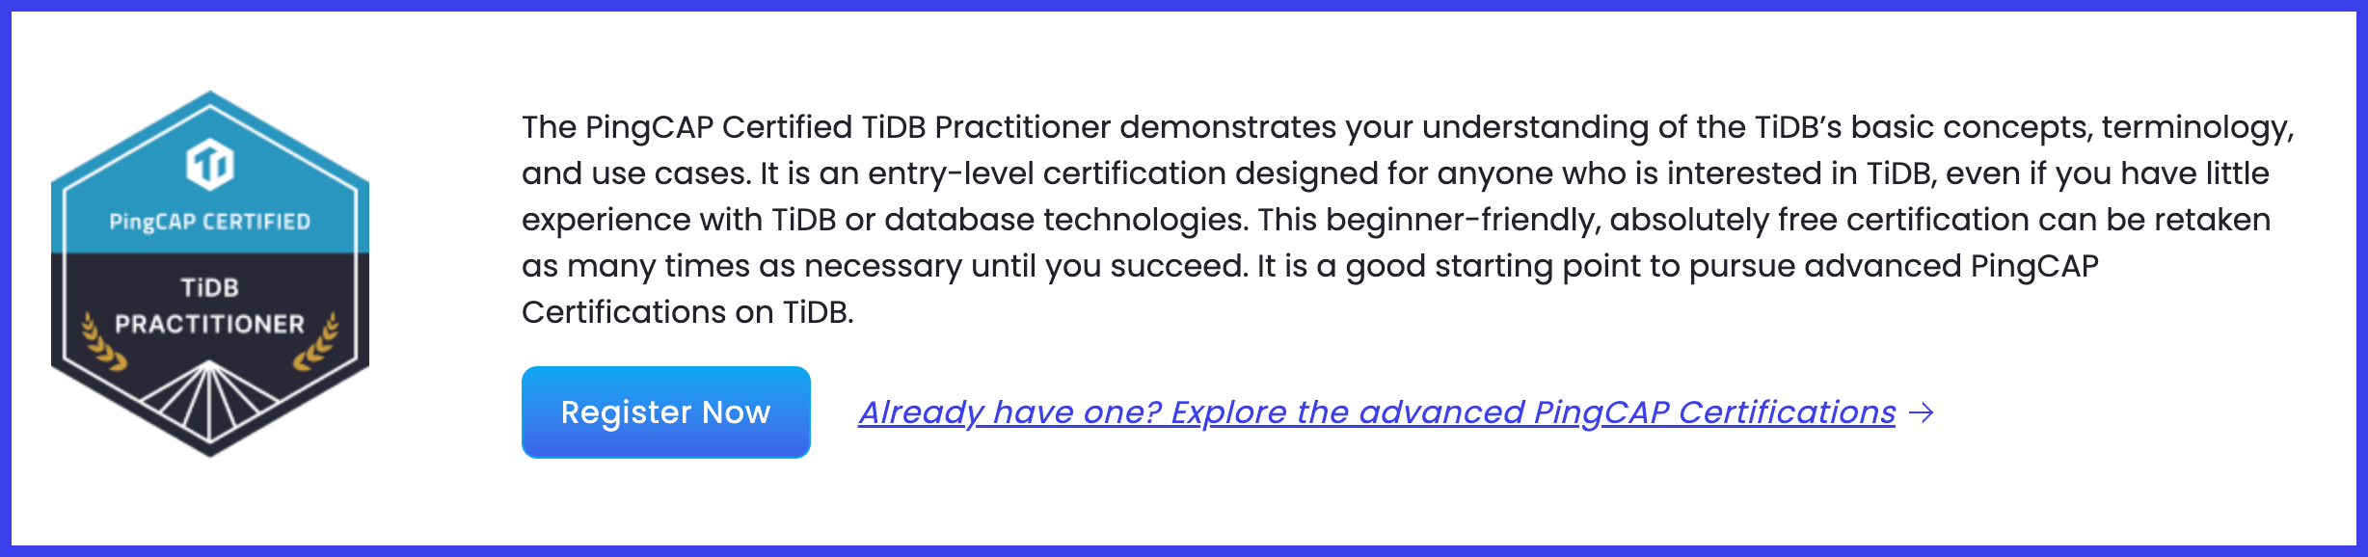
Sign-up for the TiDB Certified Practitioner Exam
pingcap.com/education/certification

Slide 76
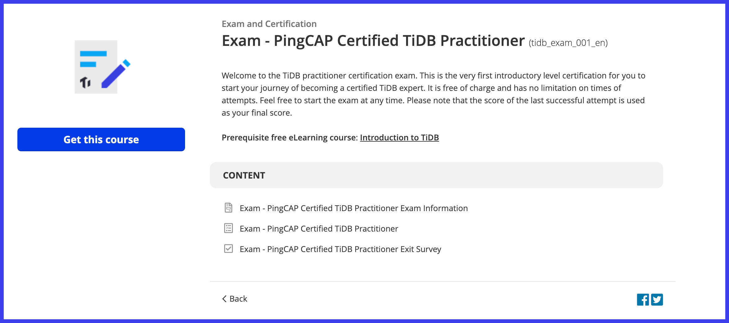
Sign-up for the TiDB Certified Practitioner Exam
Make sure it says, “TiDB Practitioner Exam”
Then, Click Here!

Slide 77
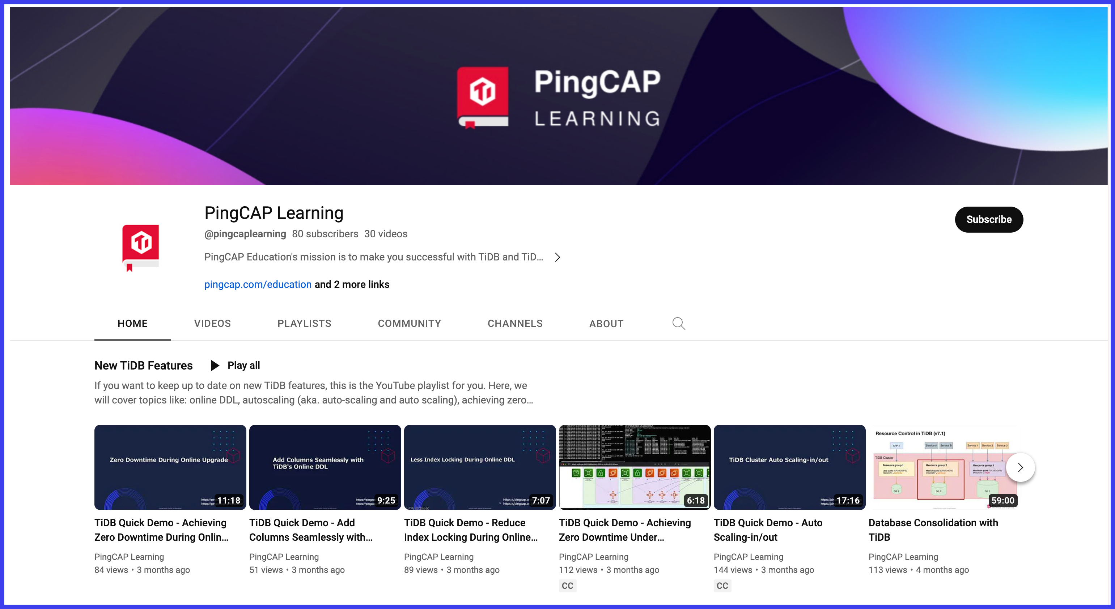
Subscribe to the PingCAP Learning Channel on YouTube
youtube.com/@pingcaplearning
Then,
click Subscribe!

Slide 78
The End!

Slide 79
Jeff Bailey PingCAP NA/EMEA Education Regional Manager jbailey.io/about/presentations-and-writing linkedin.com/in/jeffreydbailey/

